Slide 1


Correct 1000 exams with a bit of OpenCV
Language: | English
Level: | Beginner-Conceptual
Topics: | Numpy, Matplotlib, OpenCV, Digital images
Materials: | Github → AunSiro → Correct 1000….

Slide 2
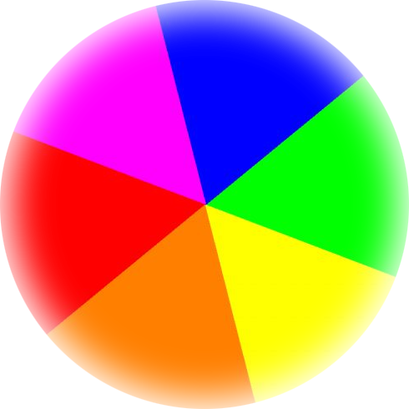

TL;DR
~ 350 Tests had to be corrected and scored in a week
Guess I’ll die use Python? ¯\_(ツ)_/¯

Slide 3
How is an image stored?
 |  |  |  |  |  |  |  |  |  |  | 255 | 255 | 255 | 0 | 0 | 0 | 0 | 255 | 255 | 255
 |  |  |  |  |  |  |  |  |  |  | 255 | 255 | 0 | 255 | 255 | 255 | 255 | 0 | 255 | 255
 |  |  |  |  |  |  |  |  |  |  | 255 | 0 | 255 | 255 | 255 | 255 | 255 | 255 | 0 | 255
 |  |  |  |  |  |  |  |  |  |  | 0 | 255 | 255 | 0 | 255 | 255 | 0 | 255 | 255 | 0
 |  |  |  |  |  |  |  |  |  |  | 0 | 255 | 255 | 255 | 255 | 255 | 255 | 255 | 255 | 0
 |  |  |  |  |  |  |  |  |  |  | 0 | 255 | 255 | 255 | 255 | 255 | 255 | 255 | 255 | 0
 |  |  |  |  |  |  |  |  |  |  | 0 | 255 | 255 | 0 | 255 | 255 | 0 | 255 | 255 | 0
 |  |  |  |  |  |  |  |  |  |  | 255 | 0 | 255 | 255 | 0 | 0 | 255 | 255 | 0 | 255
 |  |  |  |  |  |  |  |  |  |  | 255 | 255 | 0 | 255 | 255 | 255 | 255 | 0 | 255 | 255
 |  |  |  |  |  |  |  |  |  |  | 255 | 255 | 255 | 0 | 0 | 0 | 0 | 255 | 255 | 255

Slide 4
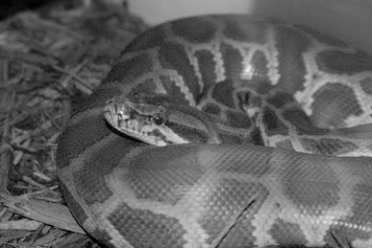
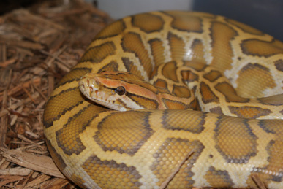
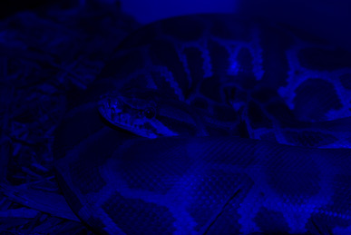
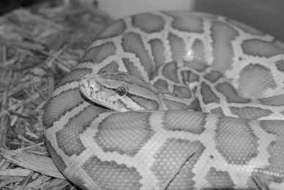
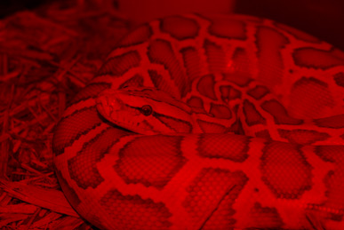
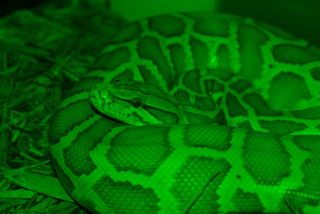
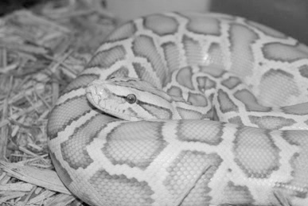
RGB: 3 x B&W Matrix = Color

Slide 5
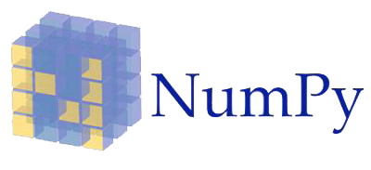
What is Numpy?
Scientific Numerical operations
Arrays & Array functions
Broadcasting, slicing…

Slide 6
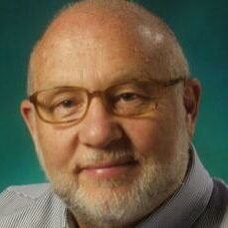
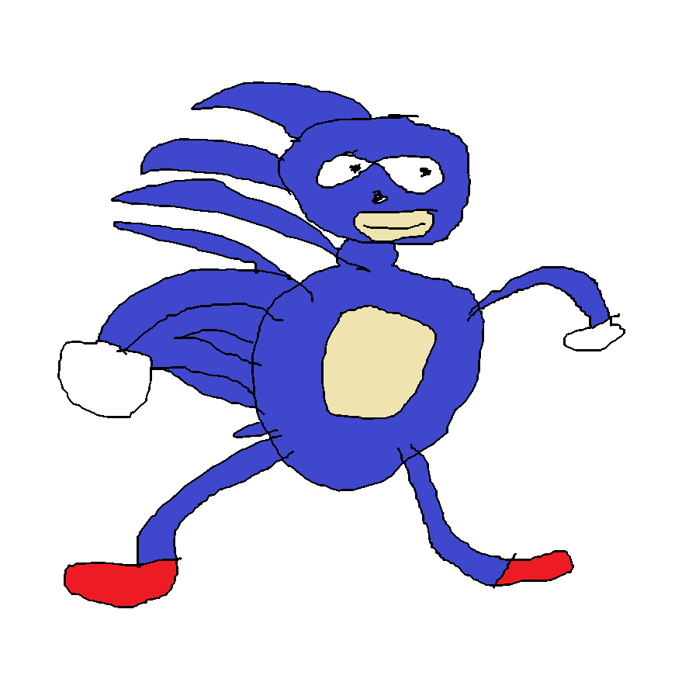
Why Numpy?
You want to use mathematical fancy things but have no time to search in stack overflow how to make them
You want your code to run fast so your Fortran expert colleagues don’t laugh at you but you don’t want to spend 5 years writing a hello world

Slide 7
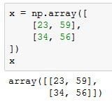

Arrays. What are they?
Arrays store matrices or vectors
Array → Matrix → Image!

Slide 8
What will we use?
Matrix functions and slicing
255 | 255 | 255 | 0 | 0 | 0 | 0 | 255 | 255 | 255
255 | 255 | 0 | 255 | 255 | 255 | 255 | 0 | 255 | 255
255 | 0 | 255 | 255 | 255 | 255 | 255 | 255 | 0 | 255
0 | 255 | 255 | 0 | 255 | 255 | 0 | 255 | 255 | 0
0 | 255 | 255 | 255 | 255 | 255 | 255 | 255 | 255 | 0
0 | 255 | 255 | 255 | 255 | 255 | 255 | 255 | 255 | 0
0 | 255 | 255 | 0 | 255 | 255 | 0 | 255 | 255 | 0
255 | 0 | 255 | 255 | 0 | 0 | 255 | 255 | 0 | 255
255 | 255 | 0 | 255 | 255 | 255 | 255 | 0 | 255 | 255
255 | 255 | 255 | 0 | 0 | 0 | 0 | 255 | 255 | 255
0 | 0 | 0 | 0
255 | 255 | 255 | 255
255 | 255 | 255 | 255
0 | 255 | 255 | 0
255 | 255 | 255 | 255
255 | 255 | 255 | 255
0 | 255 | 255 | 0
X 2

Slide 9

What is OpenCV?
Open Source Computer Vision
Written in C/C++
Very optimized to run very fast
Contrary to popular belief, computer vision is not black magic, but science
Interface with C, C++, Python and Java
Maybe it has a little of black magic, ok
Lots of very advanced functions for everything
Actually, everything is black magic

Slide 10

What will we use OpenCV for?
Load images into Numpy arrays

Slide 11



What will we use OpenCV for?

Slide 12

What will we use OpenCV for?

Slide 13

What is
Library for drawing figures
Has a lot of different functions to create lots of different graphs
Pyplot: easy module for simple and quick graphs
Object oriented and function oriented interfaces for when you need more control

Slide 14
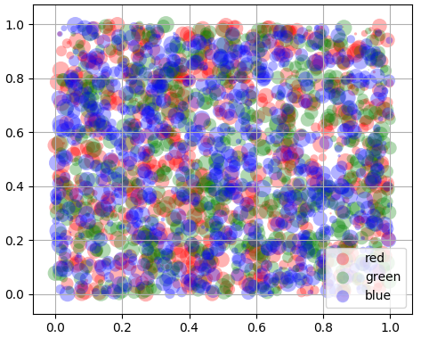

Transform your boring data into beautiful pieces of crap art
Colors are useful and beautiful, use them!
The pyplot interface is easy and agile
No, really, always represent data

Slide 15
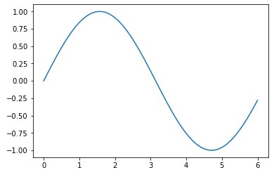
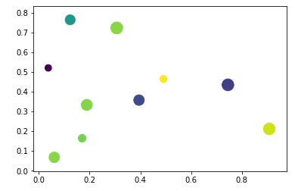
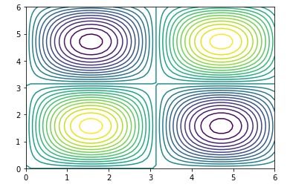
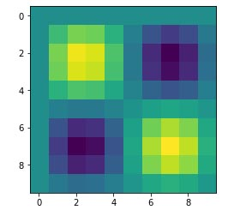
Some useful Matplotlib functions

Slide 16


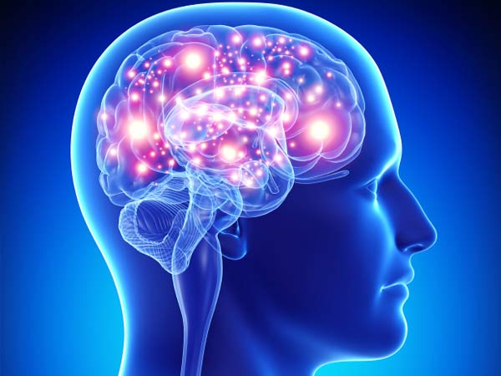
OK, so… what about the exams?

Slide 17
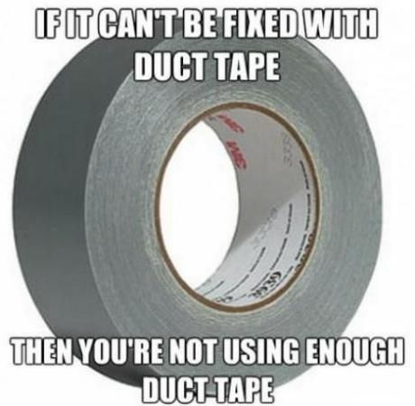
Correct a single exam with OpenCV
Witness the best practices and novel algorithms in ñapas-&-deadlines driven development

Slide 18
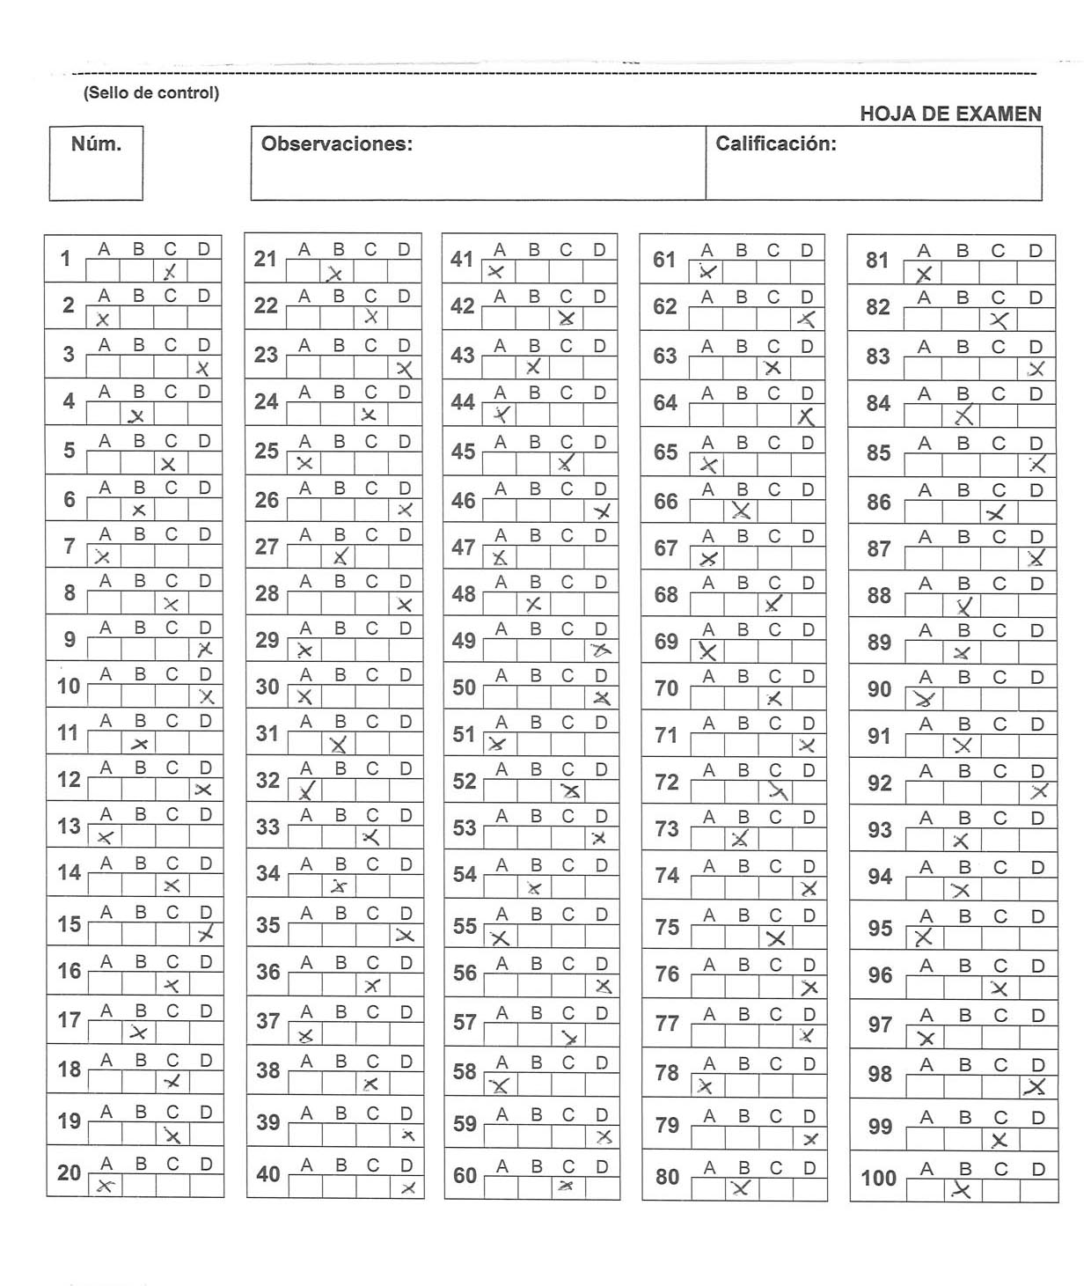

Lets look at the exam itself

Slide 19
The Rules
Draw a X on your chosen option
Draw a circle over an X to nullify it
The number of correct, incorrect and blank answers has to be registered
Gods, how I whish I could put my hands on whoever designed that stupid test without even planning on how to correct it other than by hand

Slide 20
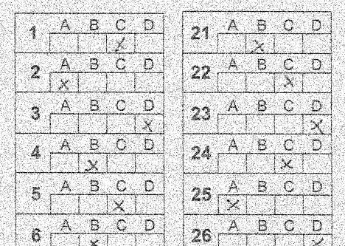
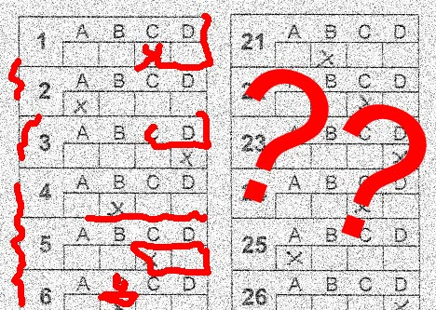
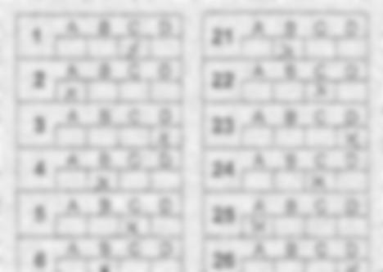
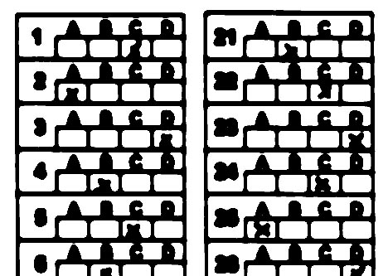
The process in detail: precondition
Blur
Threshold

Slide 21
The process in detail: straighten

Slide 22
The process in detail: extract

Slide 23

The process in detail: analyze

Slide 24
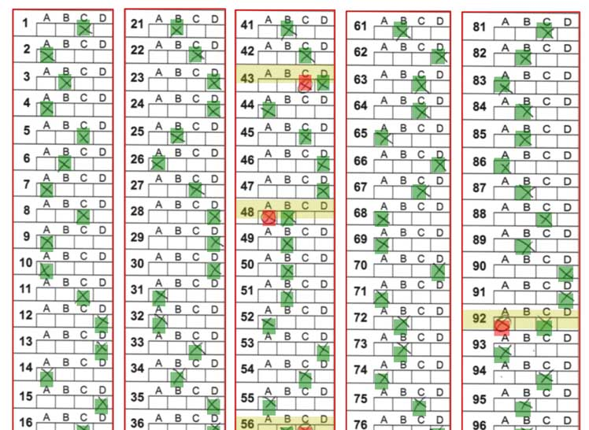
The process in detail: draw & save

Slide 25


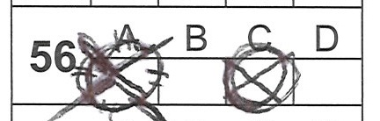
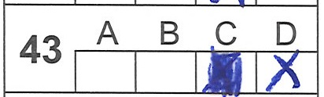
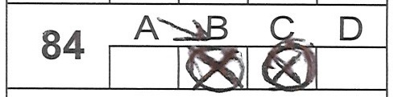

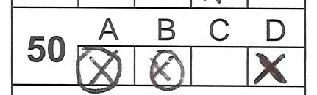
Some found problems
It is difficult to assign threshold values for nullified answers
The cells don’t have the same size (Seriously WTF who made this thing??)
No plan survives contact with the enemy

Slide 26
[Rinse and Repeat] X 300
Analyze a (hopefully) correct template
Make a loop and let the computer do the job for you (haha stupid machine)
Check the results and correct if necessary
???
Profit

Slide 27
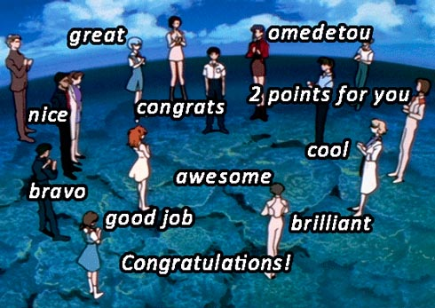
Congratulations!
Mission Accomplished!
You just spent a week learning how to teach Python how to correct exams instead of correcting exams!

Slide 28
Additional libraries used:
Imutils : some useful functions to work with OpenCV
Openpyxl: read & write excel files
Os: operative system functions
This project is based on the tutorial
“Bubble sheet multiple choice scanner and
test grader using OMR, Python and OpenCV”
by Adrian Rosebrock:Link

Slide 29
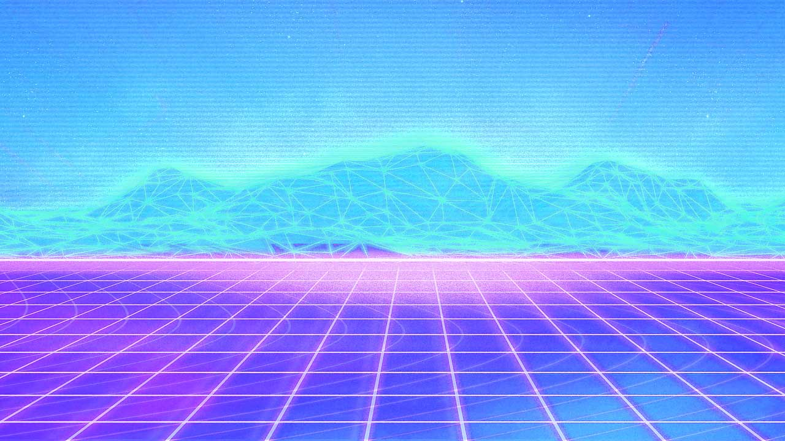
Thank you
for not falling sleep
Download scripts, examples, etc:
Github → AunSiro → Correct 1000….

